Slide 1
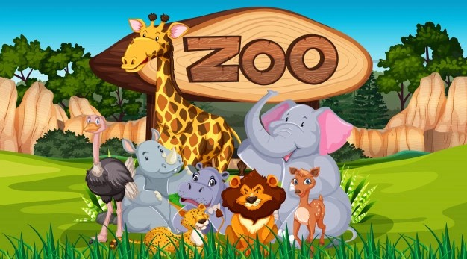
Notes:
Hello, My name is Seonhye Yoon, and Today I’ll gonna say “Is it right to have zoos?”
Has anyone never been to a zoo or aquariums?
Most people visit zoo and aquariums at least once for educational or entertaining purposes.
They are so close to us, and that’s why people should pay attention how the animals are living in the zoo and aquariums.

Slide 2
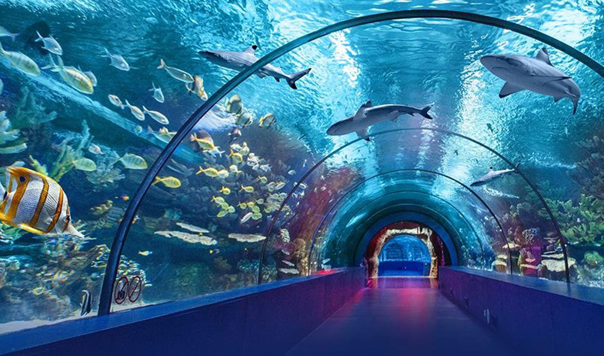
Notes:
According to the Oxford Languages, the definition of zoo is “an establishment which maintains a collection of wild animals, typically in a park or gardens, for study, conservation, or display to the public.”
However, there is also a view that the zoo itself is not for animals, but it is abusing them.

Slide 3
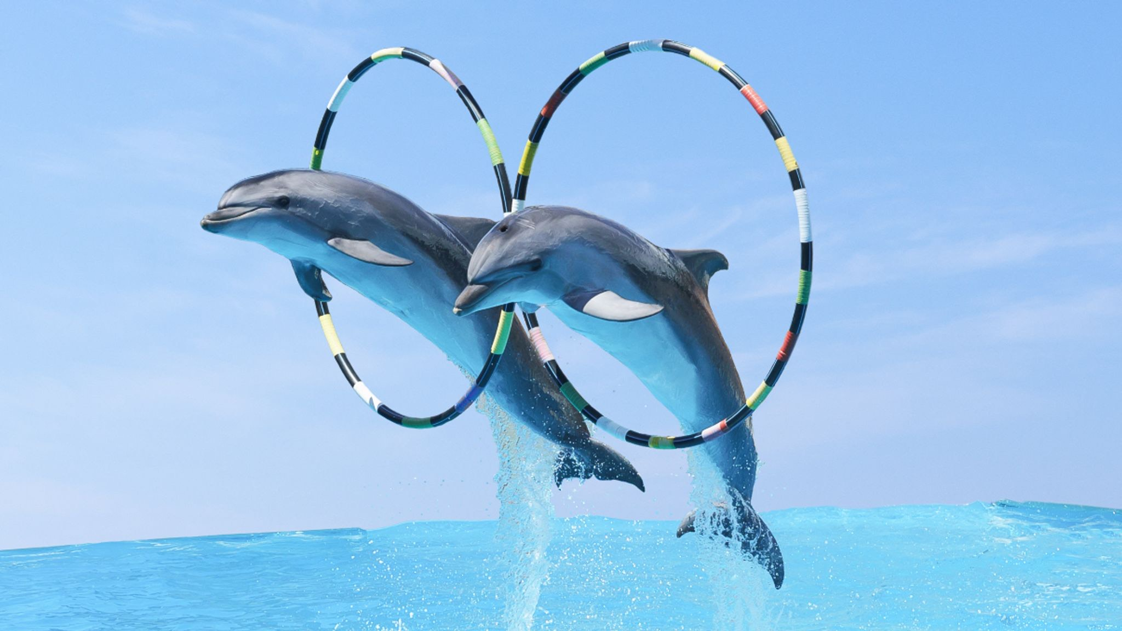
Notes:
For example, Dolphins.
Have you ever seen dolphin shows or heard about dolphin ride activity?
Dolphins are cute and smart, so they are one of the most popular animals for shows.
That's how many cases of abuse are.
For this case, there is the Georgia Aquarium, notorious as "dying pool". From 2012 to 2015, 3 belugas and 5 dolphins died in there.

Slide 4
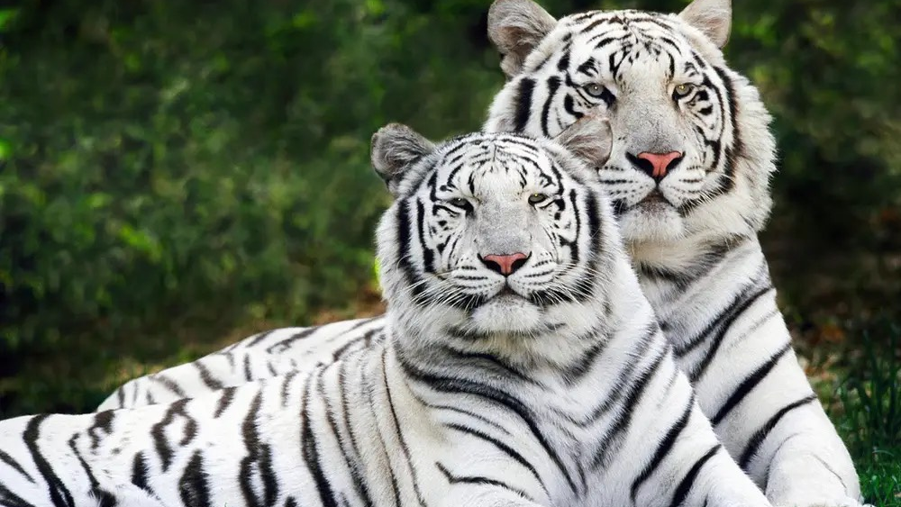
Notes:
How about white tiger. Have you ever heard about white tiger tragedy?
A white tiger is close to a mutation with a rare recessive gene. However, we can see them more commonly than before.
Why?
It’s because inbreeding. In fact, all white tigers currently raised in the United States have the same male tiger as their ancestor.

Slide 5

Notes:
Then, Should people close all the zoos?
Actually, no. Not only it is impossible, but also there are ways to improve the living environment of animals.

Slide 6
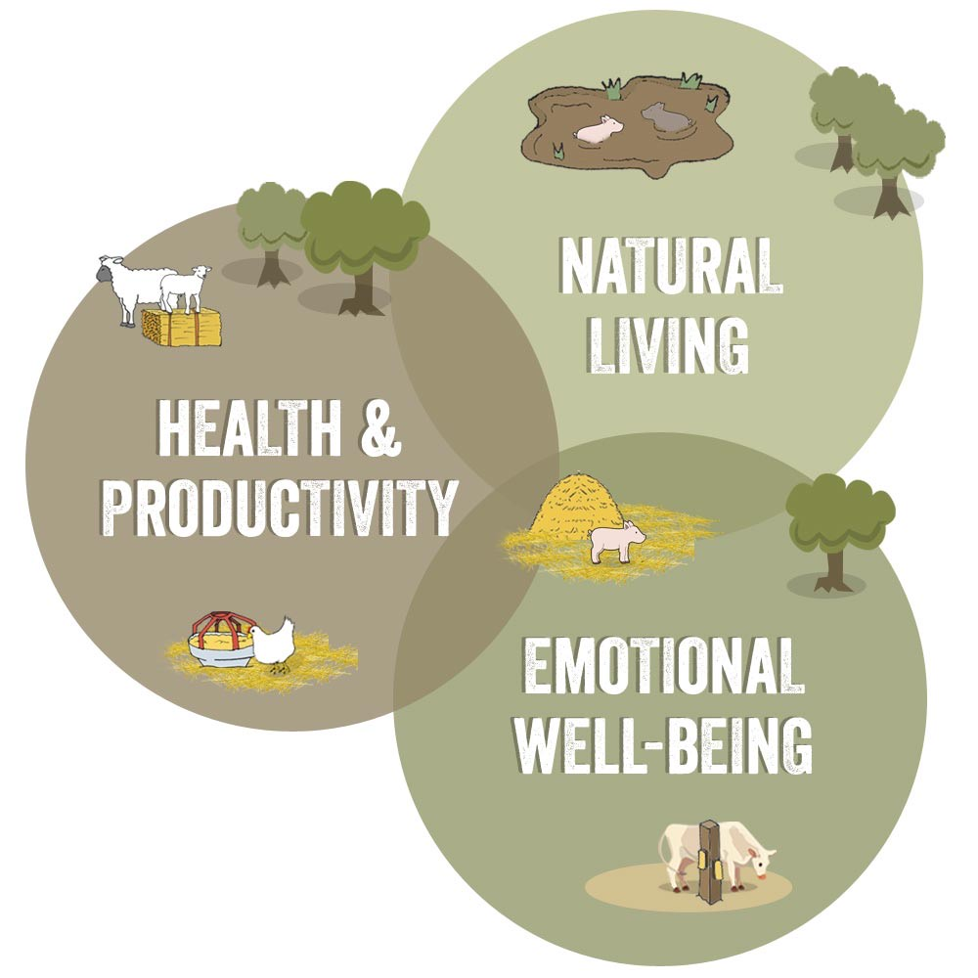
Notes:
Animal Welfare Science.
It considers these three; Natural Living, Health & Productivity, and Emotional Well-Being.
Animal welfare researchers consider the various characteristics of each animal and help them live happier and more satisfied.
Zoos should consider these factors and improve the environment of animals.

Slide 7
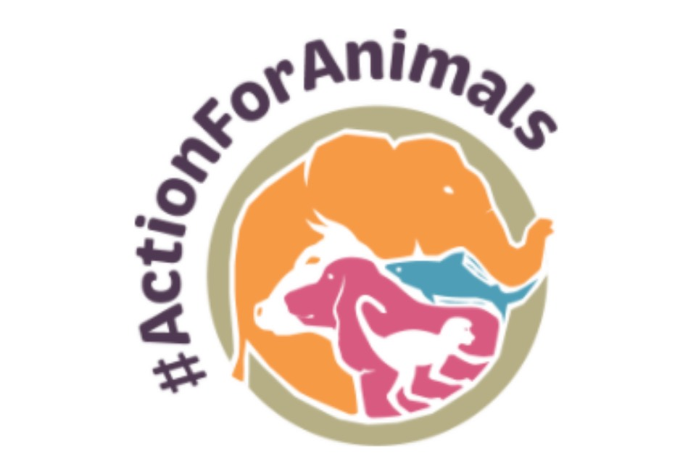
Notes:
Also, people should not visit zoos or aquariums that abuse animals.
You can check the World Association of Zoos and Aquariums certification to avoid those facilities.
Thank you, and if you have any question, feel free to ask.

Slide 8
References
Zoo
https://kr.freepik.com/free-vector/zoo-animals-in-the-wild-nature-background_8696768.htm
Aquarium
https://www.goturkeytourism.com/things-to-do/discover-underwater-world-at-aquariums-in-turkey.html
White Tiger
https://www.businessinsider.com/white-tigers-are-man-made-freaks-2012-12?amp
Dolphins
https://news.sky.com/story/amp/expedia-stops-selling-holidays-that-include-experiences-with-captive-dolphins-and-whales-12462718
NoZoos
https://www.amazon.com/MAGNET-Sticker-Animal-Magnetic-sticker/dp/B07RQCK32V
Animal Welfare Diagram
https://www.globalanimalpartnership.org/5-step-animal-welfare-rating-program
Act for Animals
https://www.gov.uk/government/news/uk-to-lead-the-way-on-animal-welfare-through-flagship-new-action-plan

